Slide 1

Chapter 3 Transport Layer
Computer Networking: A Top-Down Approach 8th edition Jim Kurose, Keith Ross Pearson, 2020
Acknowledgement: Based on the textbook’s website: https://gaia.cs.umass.edu/kurose_ross/index.php
Notes:
Version History
8.0 (April 2020)
All slides reformatted for 16:9 aspect ratio
All slides updated to 8th edition material
Use of Calibri font, rather that Gill Sans MT
Add LOTS more animation throughout
added new 8th edition material on QUIC, CUBIC, delay-based congestion control
lighter header font
8.2 (July 2023): changes from 8.0
minor updates throughout, but not much changes from 8.0

Slide 2

Chapter 3: roadmap
Transport-layer services
Multiplexing and demultiplexing
Connectionless transport: UDP
Connection-oriented transport: TCP
segment structure
reliable data transfer
flow control
connection management
Principles of congestion control
TCP congestion control

Slide 3

TCP sequence numbers, ACKs
IMPORTANT
Host A
Host B
User types‘C’
Seq=42, ACK=79, data = ‘C’
host ACKs receipt of‘C’, echoes back ‘C’
Seq=79, ACK=43, data = ‘C’
host ACKs receipt of echoed ‘C’
Seq=43, ACK=80
simple telnet scenario
Notes:
The key thing to note here is that the ACK number (43) on the B-to-A segment is one more than the sequence number (42) on the A-to-B segment that triggered that ACK
Similarly, the ACK number (80) on the last A-to-B segment is one more than the sequence number (79) on the B-to-A segment that triggered that ACK

Slide 4
TCP Sender (simplified)
IMPORTANT
event: data received from application
create segment with seq #
seq # is byte-stream number of first data byte in segment
start timer if not already running
think of timer as for oldest unACKed segment
expiration interval: TimeOutInterval
event: timeout
retransmit segment that caused timeout
restart timer
event: ACK received
if ACK acknowledges previously unACKed segments
update what is known to be ACKed
start timer if there are still unACKed segments
Notes:
Given these details of TCP sequence numbers, acks, and timers, we can now describe the big picture view of how the TCP sender and receiver operate
You can check out FSMs in book; let’s just give an English text description here and let’s start with the sender.

Slide 5
TCP Receiver: ACK generation [RFC 5681]
Event at receiver
arrival of in-order segment with
expected seq #. All data up to
expected seq # already ACKed
arrival of in-order segment with
expected seq #. One other
segment has ACK pending
arrival of out-of-order segment
higher-than-expect seq. # .
Gap detected
arrival of segment that
partially or completely fills gap
TCP receiver action
delayed ACK. Wait up to 500ms
for next segment. If no next segment,
send ACK
immediately send single cumulative
ACK, ACKing both in-order segments
immediately send duplicate ACK,
indicating seq. # of next expected byte
immediate send ACK, provided that
segment starts at lower end of gap
Notes:
Rather than immediately Acknowledging this segment, many TCP implementations will wait for half a second for another in-order segment to arrive, and then generate a single cumulative ACK for both segments – thus decreasing the amount of ACK traffic. The arrival of this second in-order segment and the cumulative ACK generation that covers both segments is the second row in this table.

Slide 6
TCP: retransmission scenarios
Host A
Host B
Host A
Host B
SendBase=92
Seq=92, 8 bytes of data
Seq=92, 8 bytes of data
timeout
timeout
Seq=100, 20 bytes of data
ACK=100
X
ACK=100
ACK=120
Seq=92, 8 bytes of data
Seq=92, 8
bytes of data
SendBase=100
send cumulative
ACK for 120
SendBase=120
ACK=100
ACK=120
SendBase=120
lost ACK scenario
premature timeout
Notes:
To cement our understanding of TCP reliability, let’s look a a few retransmission scenarios
In the first case a TCP segments is transmitted and the ACK is lost, and the TCP timeout mechanism results in another copy of being transmitted and then re-ACKed a the sender
In the second example two segments are sent and acknowledged, but there is a premature timeout e for the first segment, which is retransmitted. Note that when this retransmitted segment is received, the receiver has already received the first two segments, and so resends a cumulative ACK for both segments received so far, rather than an ACK for just this fist segment.

Slide 7
TCP: retransmission scenarios
Host A
Host B
Q: what happens if the segment with Seq=92, 8 bytes of data from Host A to Host B gets lost?
A: Host B will not send ACK=120, since a cumulative ACK=120 implies that all previous segments with Seq <= 120 have been received
Seq=92, 8 bytes of data
Seq=100, 20 bytes of data
ACK=100
X
ACK=120
Seq=120, 15 bytes of data
cumulative ACK covers for earlier lost ACK
Notes:
And in this last example, two segments are again transmitted, the first ACK is lost but the second ACK, a cumulative ACK arrives at the sender, which then can transmit a third segment, knowing that the first two have arrived, even though the ACK for the first segment was lost

Slide 8
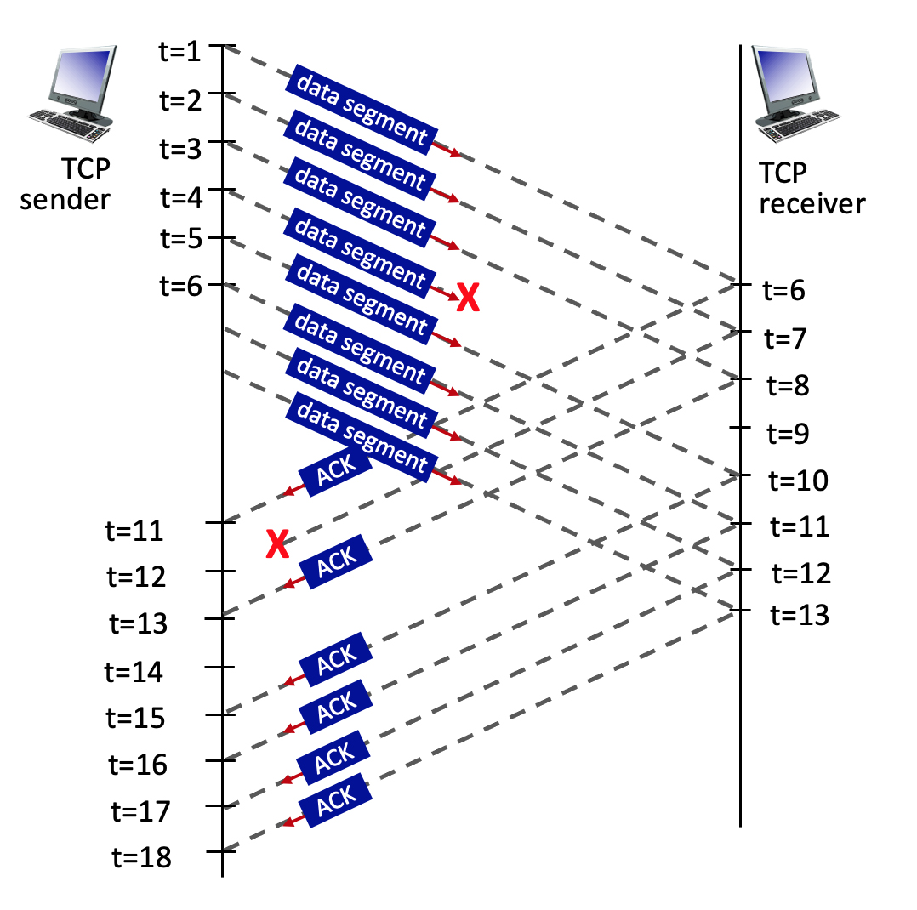
3.5-2a. TCP sequence and ACK numbers.
Consider the figure, where a TCP sender sends 8 TCP segments at t = 1, 2, 3, 4, 5, 6, 7, 8. Suppose the initial value of the sequence number is 0 and every segment sent to the receiver each contains 100 bytes. The delay between the sender and receiver is 5 time units, and so the first segment arrives at the receiver at t = 6. The ACKs sent by the receiver at t = 6, 7, 8, 10, 11, 12 are shown. The TCP segments (if any) sent by the sender at t = 11, 13, 15, 16, 17, 18 are not shown. The segment sent at t=4 is lost, as is the ACK segment sent at t=7.
Q: What is the sequence number of the segment sent at t=2?
A: 0+100=100.
See notes for explanations
Notes:
TCP uses sequence numbers to keep track of the bytes sent in a data stream. Each byte of data is assigned a unique sequence number.
## Given Information
- Initial sequence number: 0
- Each segment contains 100 bytes
- Segments are sent at t = 1, 2, 3, 4, 5, 6, 7, 8
## Calculating the Sequence Number
To find the sequence number of the segment sent at t=2, we need to consider the following:
1. The initial sequence number is 0 for the first segment (t=1).
2. Each segment contains 100 bytes.
3. The sequence number for each subsequent segment increases by the number of bytes in the previous segment.
Therefore:
- Segment at t=1: Sequence number = 0
- Segment at t=2: Sequence number = 0 + 100 = 100
## Explanation
The sequence number for the segment sent at t=2 is 100. This is because:
1. The first segment (t=1) starts with sequence number 0.
2. Each segment contains 100 bytes of data.
3. The second segment (t=2) will have a sequence number that is the sum of the initial sequence number (0) and the number of bytes in the first segment (100).
This pattern would continue for subsequent segments:
- Segment at t=3: Sequence number = 100 + 100 = 200
- Segment at t=4: Sequence number = 200 + 100 = 300
And so on.
It's important to note that the lost segment at t=4 and the lost ACK at t=7 do not affect the sequence numbers of the segments being sent. They would, however, impact the retransmission and acknowledgment process in a real TCP connection.

Slide 9
3.5-2b. TCP sequence and ACK numbers.
Consider the figure, where a TCP sender sends 8 TCP segments at t = 1, 2, 3, 4, 5, 6, 7, 8. Suppose the initial value of the sequence number is 0 and every segment sent to the receiver each contains 100 bytes. The delay between the sender and receiver is 5 time units, and so the first segment arrives at the receiver at t = 6. The ACKs sent by the receiver at t = 6, 7, 8, 10, 11, 12 are shown. The TCP segments (if any) sent by the sender at t = 11, 13, 15, 16, 17, 18 are not shown. The segment sent at t=4 is lost, as is the ACK segment sent at t=7.
Q: What is the ACK value carried in the receiver-to-sender ACK sent at t = 6?
A: 0+100=100. By sending this ACK, the receiver is telling the sender: "I've received everything up to byte 99, and I'm now expecting byte 100."
See notes for explanations
Notes:
## Understanding the Scenario
- The initial sequence number is 0.
- 8 TCP segments are sent at t = 1, 2, 3, 4, 5, 6, 7, 8.
- Each segment contains 100 bytes.
- The delay between sender and receiver is 5 time units.
- The segment sent at t=4 is lost.
- We need to determine the ACK value sent by the receiver at t = 6.
## Calculating the ACK Value
1. **Segments Received**: At t = 6, only the first segment (sent at t = 1) has arrived at the receiver due to the 5-unit delay.
2. **Bytes Received**: The first segment contains 100 bytes.
3. **ACK Mechanism**: TCP uses cumulative ACKs, which means it acknowledges all bytes up to the last contiguously received byte.
4. **ACK Value Calculation**:
- Initial sequence number: 0
- Bytes successfully received: 100
- Next expected byte: 0 + 100 = 100
Therefore, the ACK value carried in the receiver-to-sender ACK sent at t = 6 is 100.
## Explanation
The ACK value of 100 indicates that the receiver has successfully received all bytes up to, but not including, byte 100. It's essentially saying, "I've received everything up to byte 99, and I'm now expecting byte 100."
This ACK value makes sense because:
1. Only one segment has been received (the one sent at t = 1).
2. Each segment contains 100 bytes.
3. The receiver is acknowledging the receipt of the first segment and indicating it's ready for the next byte.
It's important to note that even though more segments were sent by the sender, due to the network delay, only the first segment has reached the receiver at t = 6. The lost segment at t = 4 doesn't affect this initial ACK because it hasn't even reached the receiver yet.

Slide 10
3.5-2c. TCP sequence and ACK numbers.
Consider the figure, where a TCP sender sends 8 TCP segments at t = 1, 2, 3, 4, 5, 6, 7, 8. Suppose the initial value of the sequence number is 0 and every segment sent to the receiver each contains 100 bytes. The delay between the sender and receiver is 5 time units, and so the first segment arrives at the receiver at t = 6. The ACKs sent by the receiver at t = 6, 7, 8, 10, 11, 12 are shown. The TCP segments (if any) sent by the sender at t = 11, 13, 15, 16, 17, 18 are not shown. The segment sent at t=4 is lost, as is the ACK segment sent at t=7.
Q: What is the ACK value carried in the receiver-to-sender ACK sent at t = 8?
A: 300. By sending this ACK, the receiver is telling the sender: "I have received everything up to byte 299. Please send me the next byte, which should be 300."
See notes for explanations
Notes:
To solve this TCP sequence and ACK numbers question, let's break down the scenario and analyze it step by step:
## Initial Conditions
- The initial sequence number is 0.
- Each TCP segment contains 100 bytes.
- 8 TCP segments are sent at t = 1, 2, 3, 4, 5, 6, 7, 8.
- The delay between sender and receiver is 5 time units.
- The segment sent at t=4 is lost.
- The ACK sent at t=7 is lost.
## Analysis
### Segment Arrival
The first segment arrives at the receiver at t = 6 due to the 5-unit delay. This means that by t = 8, the receiver has potentially received the segments sent at t = 1, 2, and 3.
### Sequence Numbers
Given that each segment contains 100 bytes and the initial sequence number is 0, the sequence numbers for the first four segments would be:
- Segment 1: 0-99
- Segment 2: 100-199
- Segment 3: 200-299
- Segment 4: 300-399 (but this segment is lost)
### ACK Behavior
TCP uses cumulative ACKs, meaning it acknowledges all bytes up to the ACK number minus one. The receiver will send an ACK for the highest contiguous sequence number it has received.
## Solution
At t = 8, the receiver has successfully received segments 1, 2, and 3. However, segment 4 (sent at t=4) was lost. According to TCP's cumulative ACK principle, the receiver will acknowledge all data it has received contiguously.
Therefore, the ACK value carried in the receiver-to-sender ACK sent at t = 8 will be 300.
This ACK value of 300 indicates:
1. The receiver has successfully received all bytes up to and including byte 299.
2. The next byte the receiver expects is byte 300.
3. This ACK implicitly acknowledges all previous segments (1, 2, and 3).
By sending this ACK, the receiver is telling the sender: "I have received everything up to byte 299. Please send me the next byte, which should be 300."
It's important to note that even though segments 5, 6, and possibly 7 might have arrived by t=8, the receiver cannot acknowledge them yet because segment 4 is missing, breaking the contiguous sequence of received data.

Slide 11
3.5-2d. TCP sequence and ACK numbers.
Consider the figure, where a TCP sender sends 8 TCP segments at t = 1, 2, 3, 4, 5, 6, 7, 8. Suppose the initial value of the sequence number is 0 and every segment sent to the receiver each contains 100 bytes. The delay between the sender and receiver is 5 time units, and so the first segment arrives at the receiver at t = 6. The ACKs sent by the receiver at t = 6, 7, 8, 10, 11, 12 are shown. The TCP segments (if any) sent by the sender at t = 11, 13, 15, 16, 17, 18 are not shown. The segment sent at t=4 is lost, as is the ACK segment sent at t=7.
Q: What is the ACK value carried in the receiver-to-sender ACK sent at t = 10?
A: 300. By sending this ACK, the receiver is telling the sender: "I have received everything up to byte 299. Please send me the next byte, which should be 300."
See notes for explanations
Notes:
To solve this question, let's analyze the TCP sequence and ACK numbers based on the given information:
## Initial Setup
- The initial sequence number is 0.
- Each segment contains 100 bytes.
- The delay between sender and receiver is 5 time units.
- The segment sent at t=4 is lost.
- The ACK sent at t=7 is lost.
## Sequence of Events
1. Segments sent at t=1, 2, 3 arrive at the receiver at t=6, 7, 8 respectively.
2. The receiver acknowledges these segments at t=6, 7, 8.
3. The segment sent at t=4 is lost and doesn't reach the receiver.
4. Segments sent at t=5, 6, 7, 8 arrive at the receiver at t=10, 11, 12, 13 respectively.
## ACK Value Calculation
To determine the ACK value sent at t=10, we need to consider the last successfully received byte in order.
1. The first three segments (sent at t=1, 2, 3) were successfully received and acknowledged.
- These segments cover bytes 0-99, 100-199, and 200-299.
2. The segment sent at t=4 was lost, so the next expected byte is 300.
3. Even though segments sent at t=5 have arrived by t=10, TCP uses cumulative ACKs.
Therefore, the ACK value sent at t=10 will be 300.
## Explanation
The ACK value of 300 indicates that the receiver has successfully received all bytes up to but not including byte 300. It's requesting the next expected byte, which is 300. This ACK serves two purposes:
1. It acknowledges the receipt of the first three segments.
2. It informs the sender that there's a gap in the received data, prompting a retransmission of the lost segment (sent at t=4).
Even though the receiver has likely received segments sent after the lost one, it cannot acknowledge them yet due to TCP's in-order delivery requirement. This behavior is part of TCP's reliable data transfer mechanism, ensuring that all data is received in the correct order.

Slide 12
Chapter 4 Network Layer:
Data Plane
Computer Networking: A Top-Down Approach 8th edition Jim Kurose, Keith Ross Pearson, 2020
Acknowledgement: Based on the textbook’s website: https://gaia.cs.umass.edu/kurose_ross/index.php
Notes:
Version History
8.0 (May 2020)
All slides reformatted for 16:9 aspect ratio
All slides updated to 8th edition material
Use of Calibri font, rather that Gill Sans MT
Add LOTS more animation throughout
added new 8th edition material on middleboxes (and Internet arch), Net neutrality, buffering …
lighter header font
8.2 (July 2023), changes from 8.0:
some minor updates (e.g., IPv6 stats updated) but not much has changed.

Slide 13
Network layer: “data plane” roadmap
Network layer: overview
data plane
control plane
What’s inside a router
input ports, switching, output ports
buffer management, scheduling
IP: the Internet Protocol
datagram format
addressing
network address translation
IPv6
Generalized Forwarding, SDN
Match+action
OpenFlow: match+action in action
Middleboxes

Slide 14
Packet Scheduling: FCFS
IMPORTANT
packet scheduling: deciding which packet to send next on link
first come, first served
priority
round robin
weighted fair queueing
FCFS: packets transmitted in order of arrival to output port
also known as: First-in-first-out (FIFO)
real world examples?
Abstraction: queue
R
packet
departures
packet
arrivals
queue
(waiting area)
link
(server)

Slide 15
Scheduling policies: priority
IMPORTANT
Priority scheduling:
arriving traffic classified, queued by class
any header fields can be used for classification
high priority queue
arrivals
classify
link
departures
low priority queue
2
send packet from highest priority queue that has buffered packets
FCFS within priority class
1
3
4
5
arrivals
packet in service
1
3
2
4
5
departures
1
3
2
4
5

Slide 16
Scheduling policies: round robin
IMPORTANT
Round Robin (RR) scheduling:
arriving traffic classified, queued by class
any header fields can be used for classification
server cyclically, repeatedly scans class queues, sending one complete packet from each class (if available) in turn
R
classify
arrivals
link
departures

Slide 17
Scheduling policies: weighted fair queueing
IMPORTANT
Weighted Fair Queuing (WFQ):
generalized Round Robin
each class, i, has weight, w_{i}, and gets weighted amount of service in each cycle:
w₁
w₂
R
w_{i}
Σ_{j}w_{j}
classify
arrivals
link
departures
w₃
minimum bandwidth guarantee (per-traffic-class)

Slide 18
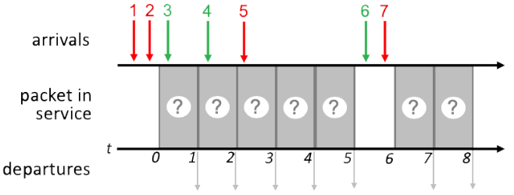
Quiz 1 4.2-7
IMPORTANT

Slide 19
FCFS Scheduling
IMPORTANT
Transmit order the same as packet arrival order of 1 2 3 4 5 6 7
1
2
3
4
5
6
7
1
2
3
4
5
6
7
1 2 3 4 5 6 7

Slide 20
Priority Scheduling
IMPORTANT
Time 0: 1, 2 in queue, transmit 1
FCFS within same priority
Time 1: 2, 3 in queue, transmit 2
Time 2: 3, 4 in queue, transmit 3
FCFS within same priority
Time 3: 4, 5 in queue, transmit 5
Time 4: 4 in queue, transmit 4
Time 6: 6, 7 in queue, transmit 7
Time 7: 6 in queue, transmit 6
1
2
3
5
4
7
6
1
2
3
5
4
7
6
1 2 3 5 4 7 6
Network Layer: 4-20

Slide 21
Round Robin Scheduling
IMPORTANT
Assume a round-robin scheduling cycle begins with red packets. i.e., (red, green) in each round.
Time 0: 1, 2 in queue, transmit 1
1st round of (red, green)
Time 1: 2, 3 in queue, transmit 3
1st round of (red, green)
Time 2: 2. 4 in queue, transmit 2
2nd round of (red, green)
Time 3: 4, 5 in queue, transmit 4
2nd round of (red, green)
Time 4: 5 in queue, transmit 5
3RD round of (red, green). Since there is no green packet ready, this round is (red, null)
Time 6: 6, 7 in queue, transmit 7
4th round of (red, green)
Time 7: 6 in queue, transmit 6
4th round of (red, green)
Summary:
Times 0-1: 1st round: (1, 3)
Times 2-3: 2nd round: (2, 4)
Time 4: 3rd round: (5, null)
No green packets ready
Times 6-7: 4th round: (7, 6)
1
3
2
4
5
7
6
1
3
2
4
5
7
6
1 3 2 4 5 7 6

Slide 22
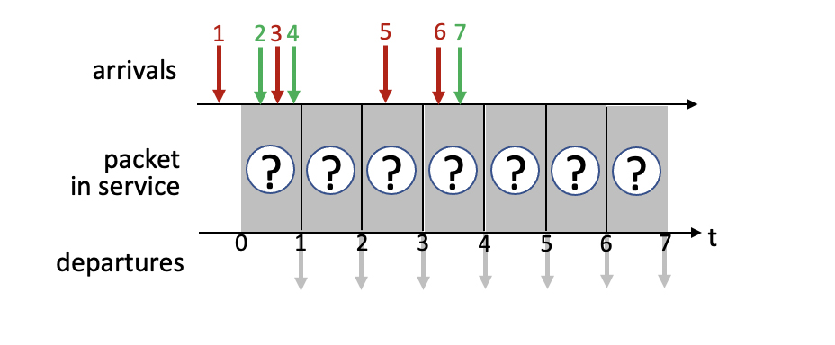
Quiz 2 4.2-3

Slide 23
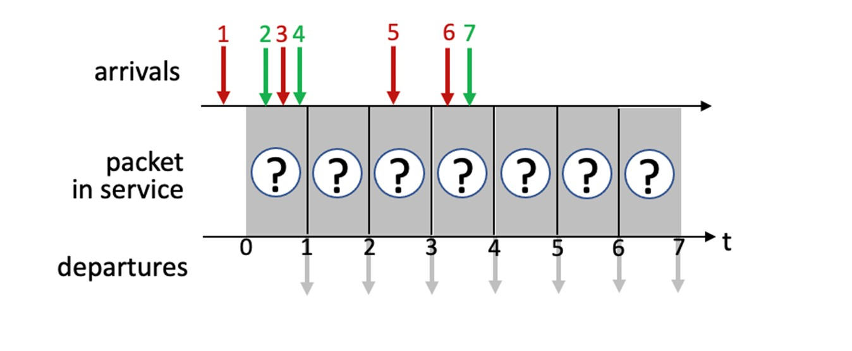
FCFS Scheduling
IMPORTANT
Transmit order the same as packet arrival order of 1 2 3 4 5 6 7
1
2
3
4
5
6
7
1
2
3
4
5
6
7
1 2 3 4 5 6 7

Slide 24
Priority Scheduling
IMPORTANT
Time 0: 1 in queue, transmit 1
Time 1: 2, 3, 4 in queue, transmit 3
Time 2: 2, 4 in queue, transmit 2
FCFS within same priority
Time 3: 4, 5 in queue, transmit 5
Time 4: 4, 6, 7 in queue, transmit 6
Time 5: 4, 7 in queue, transmit 4
Time 6: 7 in queue, transmit 7
1
2
3
4
5
6
7
1
3
2
5
6
4
7
1 3 2 5 6 4 7
Network Layer: 4-24

Slide 25
Round Robin Scheduling
IMPORTANT
Assume a round-robin scheduling cycle begins with red packets. i.e., (red, green) in each round.
Summary:
Times 0-1: 1st round: (1, 2)
Times 2-3: 2nd round: (3, 4)
Times 4-5: 3rd round: (5, 7)
No green packets ready
Time 6: 4th round: (6, null)
1
2
3
4
5
6
7
1
3
2
5
6
4
7
1 2 3 4 5 7 6

Slide 26
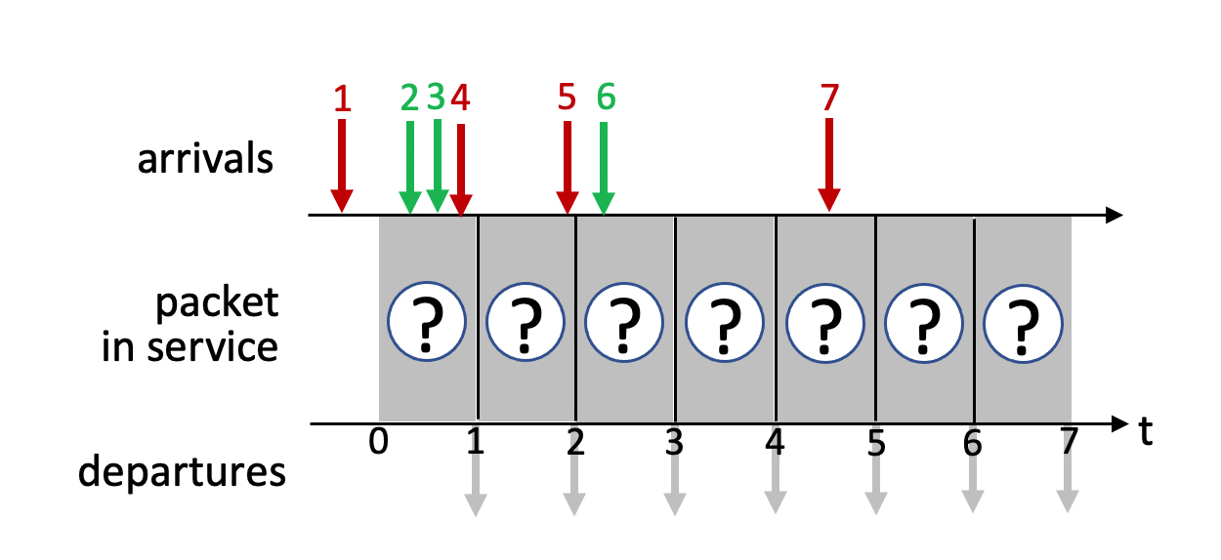
Quiz 3 4.2-4

Slide 27
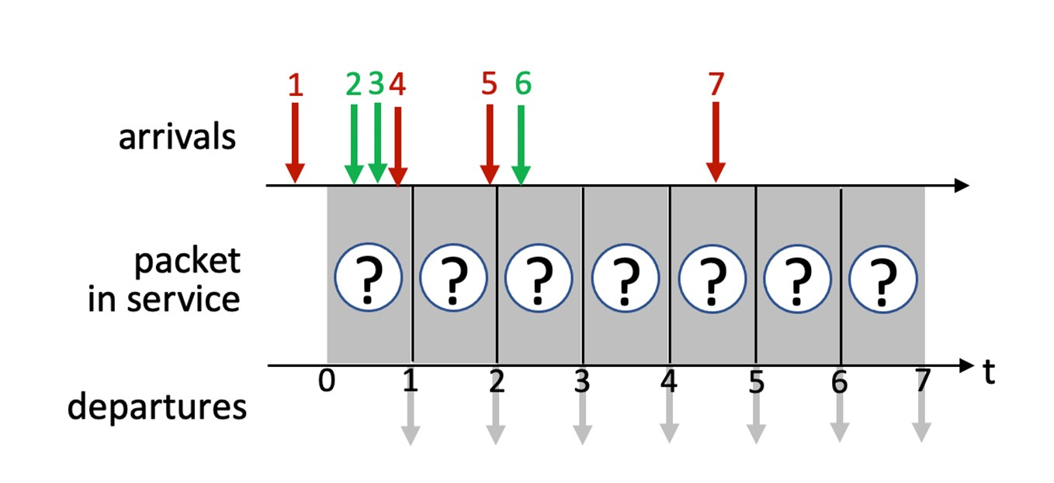
FCFS Scheduling
IMPORTANT
Transmit order the same as packet arrival order of 1 2 3 4 5 6 7
1
2
3
4
5
6
7
1
2
3
4
5
6
7
1 2 3 4 5 6 7

Slide 28
Priority Scheduling
IMPORTANT
Time 0: 1 in queue, transmit 1
Time 1: 2, 3, 4 in queue, transmit 4
Time 2: 2, 3, 5 in queue, transmit 5
Time 3: 2, 3, 6 in queue, transmit 2
Time 4: 3, 6 in queue, transmit 3
Time 5: 6, 7 in queue, transmit 7
Time 6: 6 in queue, transmit 6
1
4
5
2
3
7
6
1
4
5
2
3
7
6
1 4 5 2 3 7 6
Network Layer: 4-28

Slide 29
Round Robin Scheduling
IMPORTANT
Assume a round-robin scheduling cycle begins with red packets. i.e., (red, green) in each round.
Summary:
Times 0-1: 1st round: (1, 2)
Times 2-3: 2nd round: (4, 3)
Times 4-5: 3rd round: (5, 6)
No green packets ready
Time 6: 4th round: (7, null)
1
2
4
3
5
6
7
1
2
4
3
5
6
7
1 2 4 3 5 6 7

Slide 30
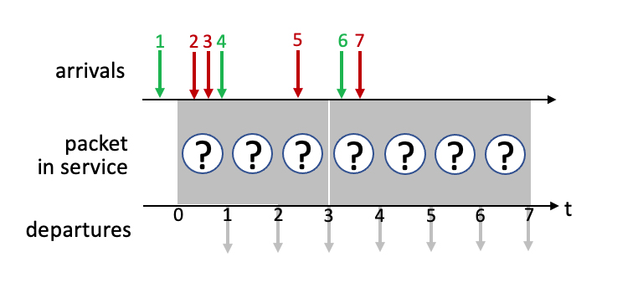
Quiz 4 4.2-1

Slide 31
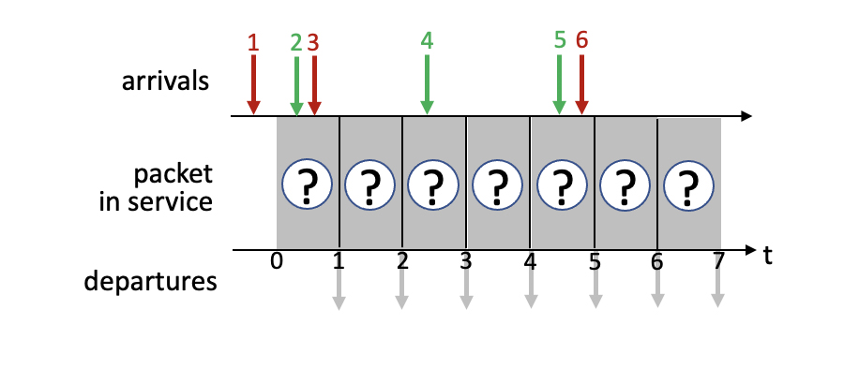
Quiz 5 4.2-2

Slide 32
Network layer: “data plane” roadmap
Network layer: overview
data plane
control plane
What’s inside a router
input ports, switching, output ports
buffer management, scheduling
IP: the Internet Protocol
datagram format
addressing
network address translation
IPv6
Generalized Forwarding, SDN
match+action
OpenFlow: match+action in action
Middleboxes

Slide 33
NAT: network address translation
IMPORTANT
NAT: all devices in local network share just one IPv4 address as far as outside world is concerned
rest of
Internet
local network (e.g., home network) 10.0.0/24
10.0.0.1
138.76.29.7
10.0.0.4
10.0.0.2
10.0.0.3
all datagrams leaving local network have same source NAT IP address: 138.76.29.7, but different source port numbers
datagrams with source or destination in this network have 10.0.0/24 address for source, destination (as usual)

Slide 34
NAT: network address translation
IMPORTANT
all devices in local network have 32-bit addresses in a “private” IP address space (10/8, 172.16/12, 192.168/16 prefixes) that can only be used in local network
advantages:
just one IP address needed from provider ISP for all devices
can change addresses of host in local network without notifying outside world
can change ISP without changing addresses of devices in local network
security: devices inside local net not directly addressable, visible by outside world

Slide 35
NAT: network address translation
IMPORTANT
implementation: NAT router must (transparently):
outgoing datagrams: replace (source IP address, port #) of every outgoing datagram to (NAT IP address, new port #)
remote clients/servers will respond using (NAT IP address, new port #) as destination address
remember (in NAT translation table) every (source IP address, port #) to (NAT IP address, new port #) translation pair
incoming datagrams: replace (NAT IP address, new port #) in destination fields of every incoming datagram with corresponding (source IP address, port #) stored in NAT table

Slide 36
NAT: network address translation
IMPORTANT
NAT translation table
WAN side addr LAN side addr
2: NAT router changes datagram source address from 10.0.0.1, 3345 to 138.76.29.7, 5001,
updates table
1: host 10.0.0.1 sends datagram to 128.119.40.186, 80
138.76.29.7, 5001 10.0.0.1, 3345
…… ……
S: 10.0.0.1, 3345
D: 128.119.40.186, 80
10.0.0.1
1
2
S: 138.76.29.7, 5001
D: 128.119.40.186, 80
10.0.0.4
10.0.0.2
138.76.29.7
S: 128.119.40.186, 80
D: 10.0.0.1, 3345
4
S: 128.119.40.186, 80
D: 138.76.29.7, 5001
3
10.0.0.3
3: reply arrives, destination address: 138.76.29.7, 5001

Slide 37
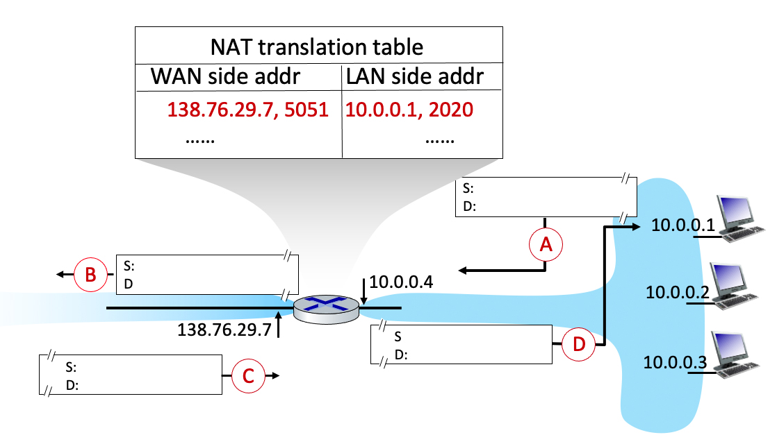
Quiz
4.3-2a Network Address Translation (a). Consider the following scenario in which host 10.0.0.1 is communicating with an external web server at IP address 128.119.40.186, port 80. The NAT table shows the table entry associated with this TCP flow. What are the source and destination IP address and port numbers at points A B C D?

Slide 38
S: 10.0.0.1, 2020
D: 128.119.40.186, 80
S: 138.76.29.7, 5051
D: 128.119.40.186, 80
S: 128.119.40.186, 80
D: 10.0.0.1, 2020
S: 128.119.40.186, 80
D: 138.76.29.7, 5051

